Slide 1
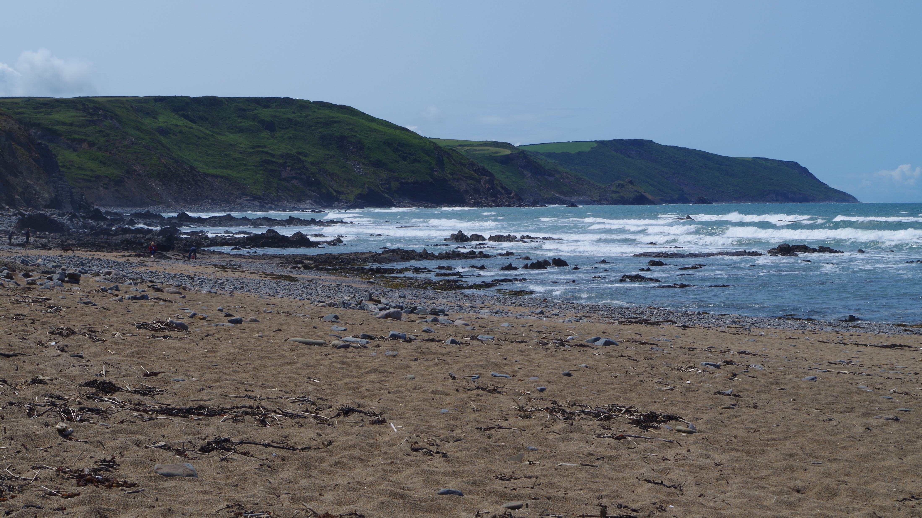

Routeways for learners
Mr G A Neighbour FGS
Careers Leader and Head of Geology

Slide 2
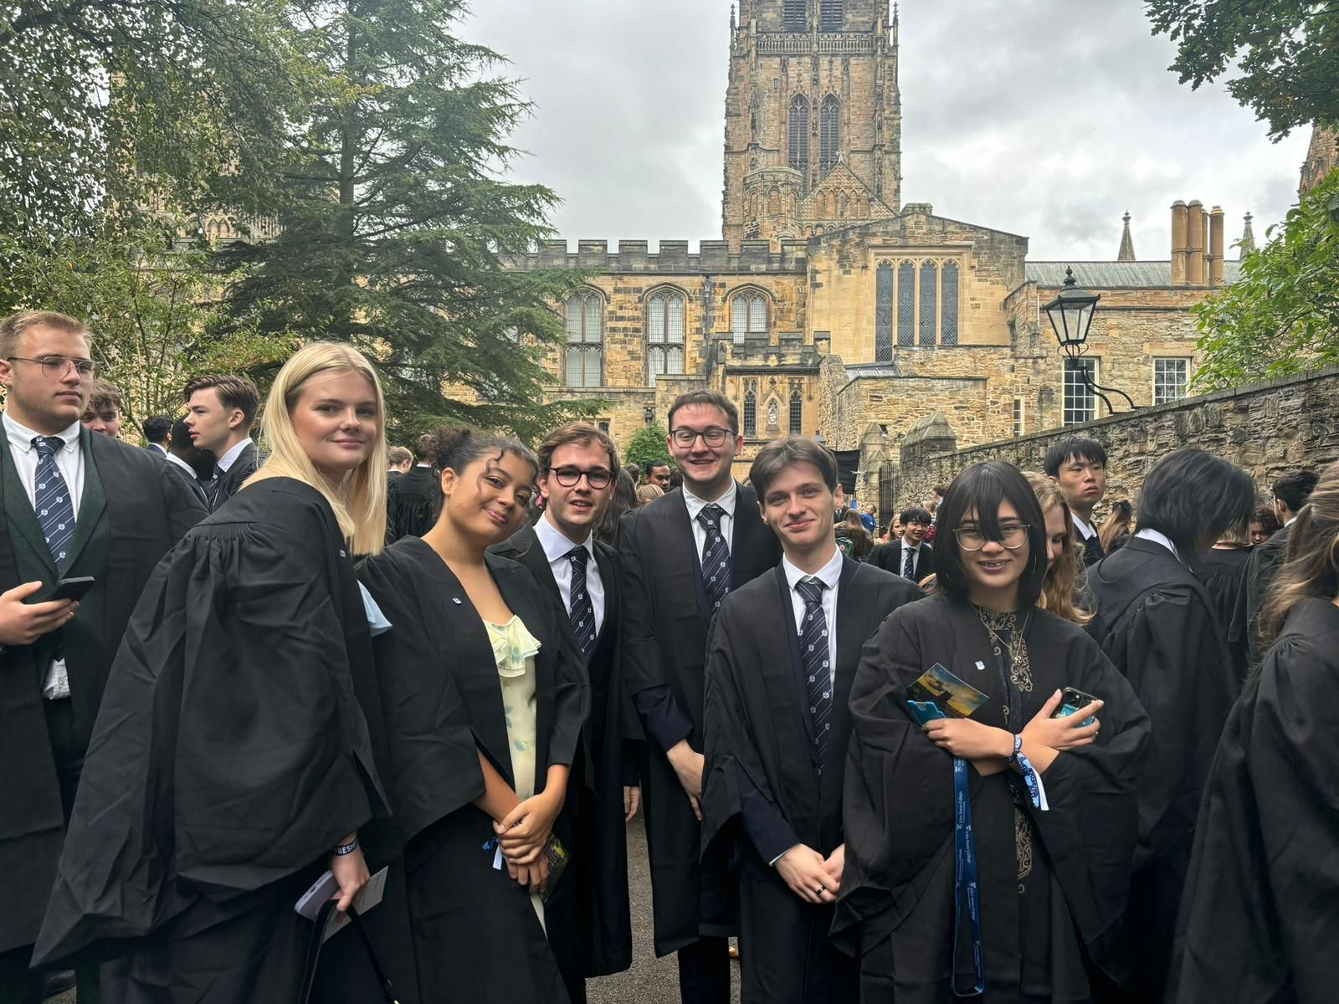
Why we do it…
As children, many of us have that one subject that just clicks.
For some it’s English, for others it’s maths, art, or science. For me, it was Computer Science.
I was that kid, often the only girl, who lit up exploring the digital world. I had an amazing teacher, Gordon Neighbour, who saw my potential and encouraged me to keep going, even when I doubted myself.

Slide 3
Routeways Post-16 → Your options
There are 3 main pathways you can take:
stay in full-time education
start an apprenticeship
spend 20 hours or more a week working or volunteering, alongside part-time education or training
Your full-time education options include:
A levels
Vocational Technical Qualifications (VTQ) such as BTEC or Cambridge technical
T Levels which you can do at further education college

Slide 4
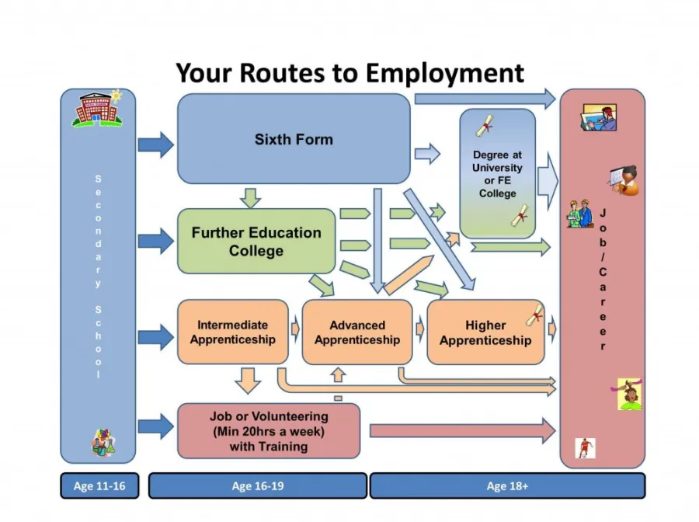
Planning your next steps
One of the things that will help you decide on the routeway for you are the options at Post-18.

Slide 5
Routeways Post-18 → Your options
Once you turn 18, you can:
apply for further study and continue education part-time or full-time.
take a gap year or volunteer to develop yourself and your skills.
start a full-time job, apprenticeship, internship or training.

Slide 6
Routeways Post-18 → Considerations
There are lots of things to consider with courses, such as:
whether you’d like to study an undergraduate degree or look into higher technical qualifications.
whether or not you’ll need to move away from home for study.
if you’ll need to borrow money for tuition fees - you can find out about student finance.
if your preferred career requires a specific qualification.

Slide 7






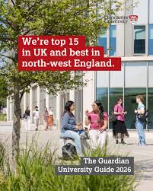

Important – research – using the right resources

Slide 8


Important – research – two good unbiased resources

Slide 9

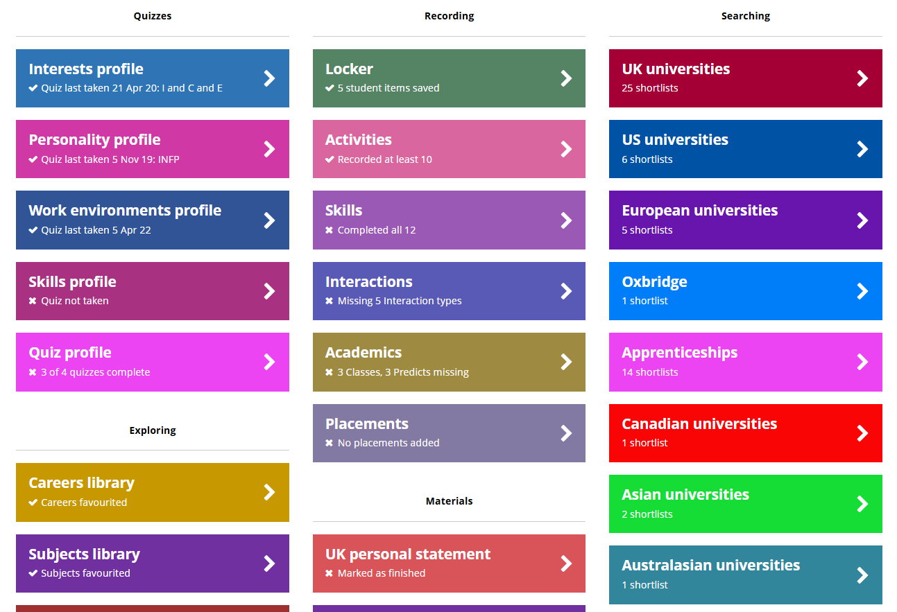
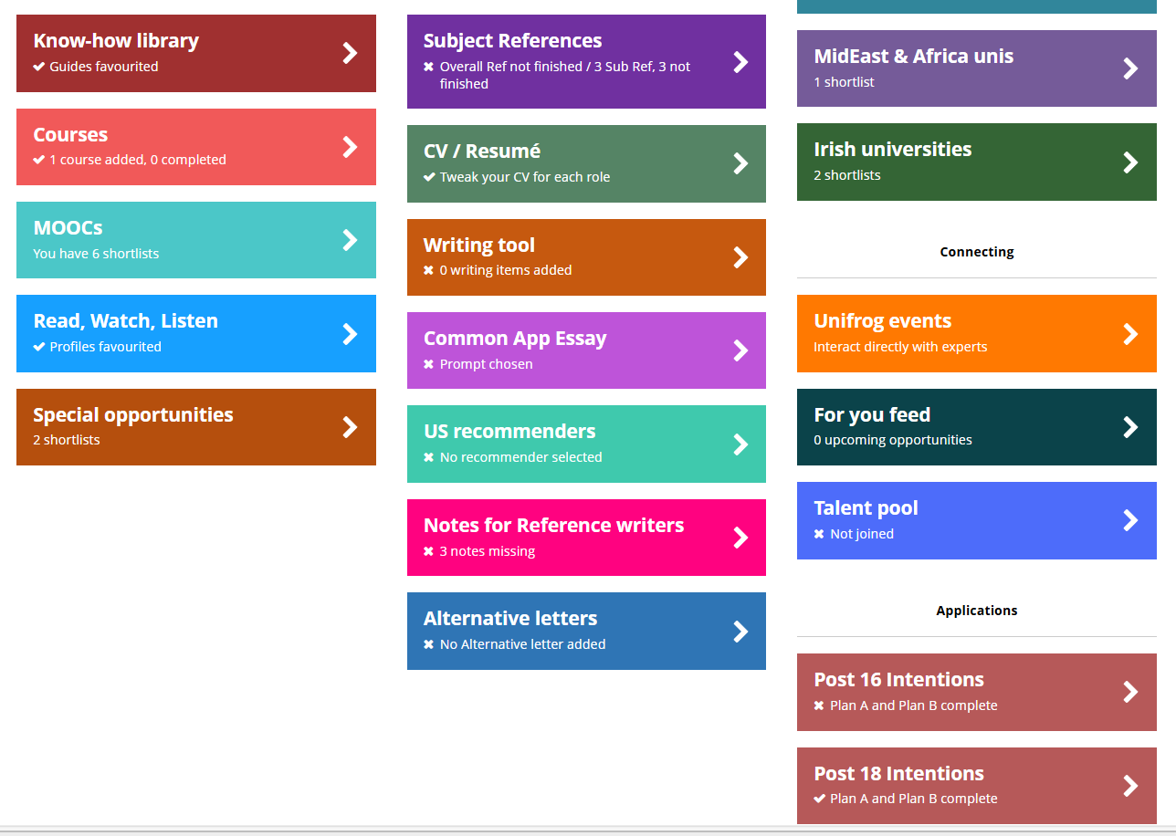

Slide 10
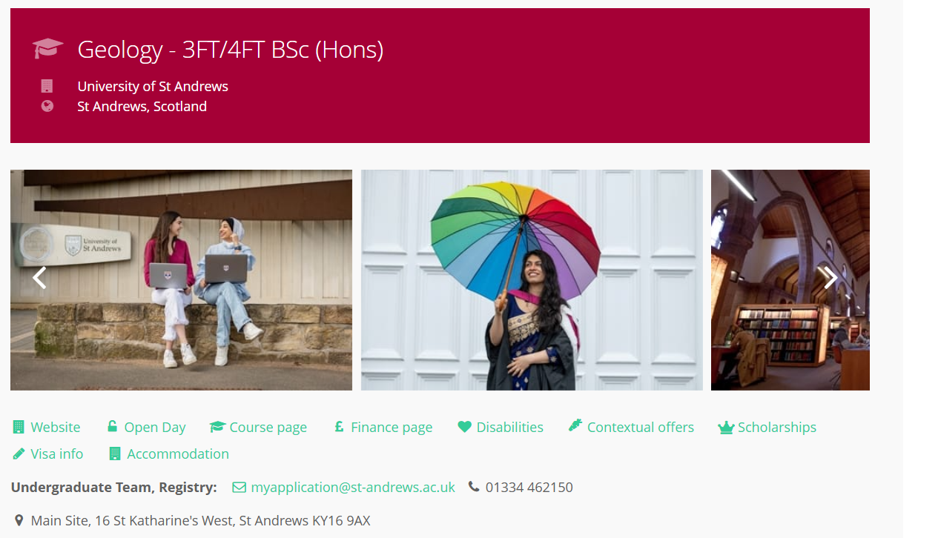
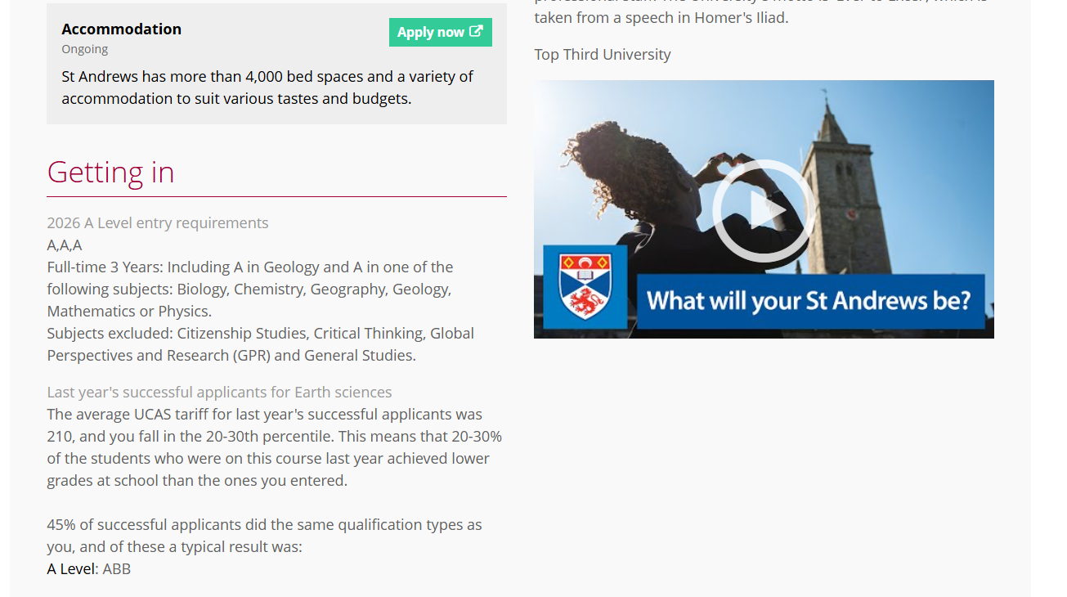

Slide 11
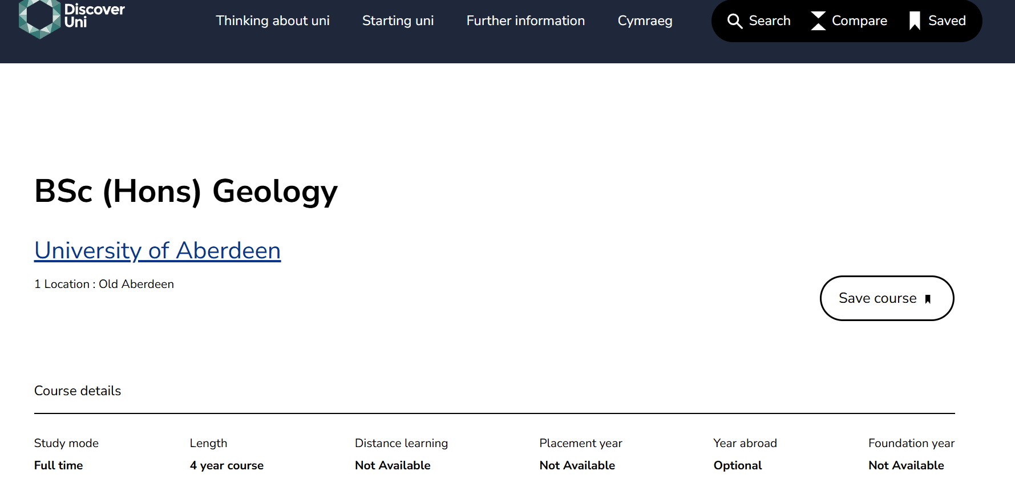

Slide 12
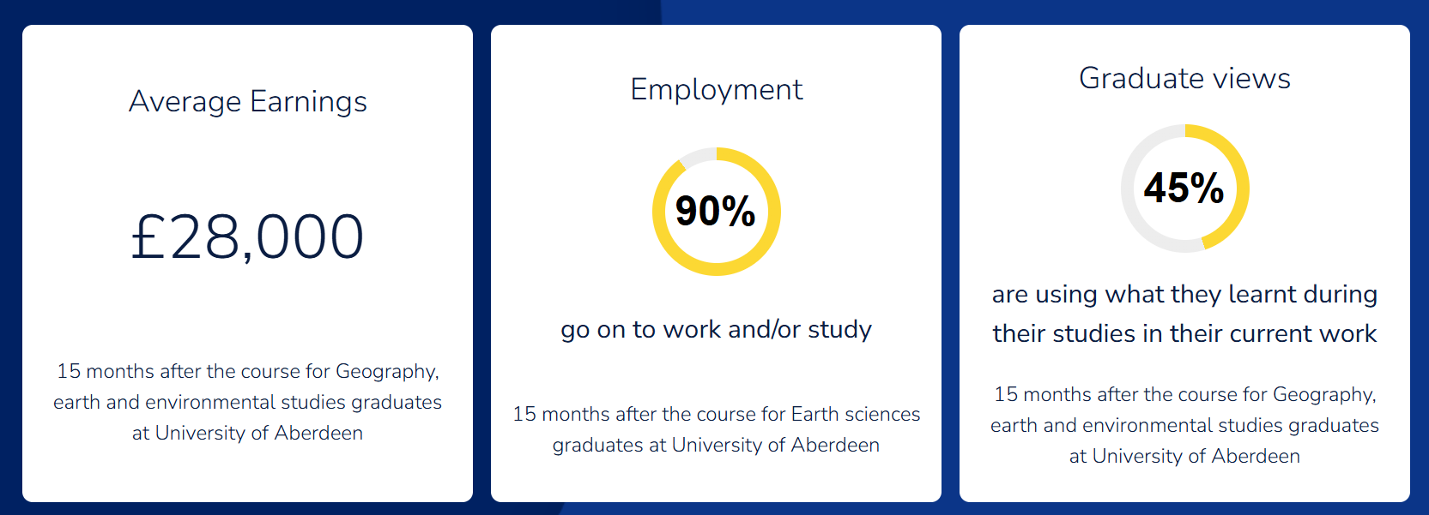

Slide 13
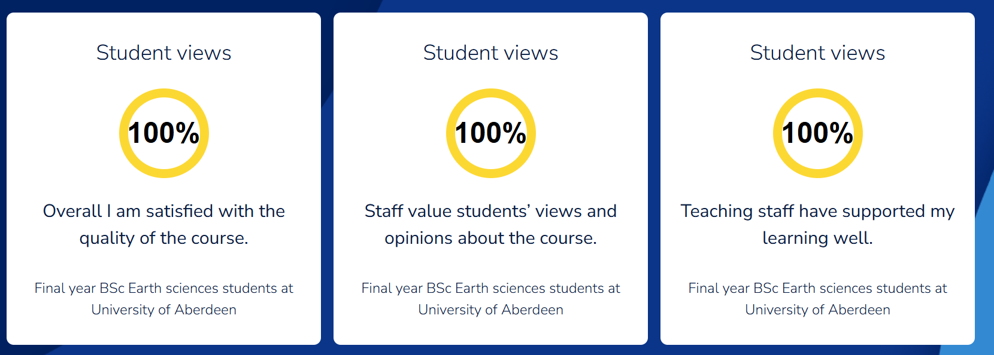

Slide 14
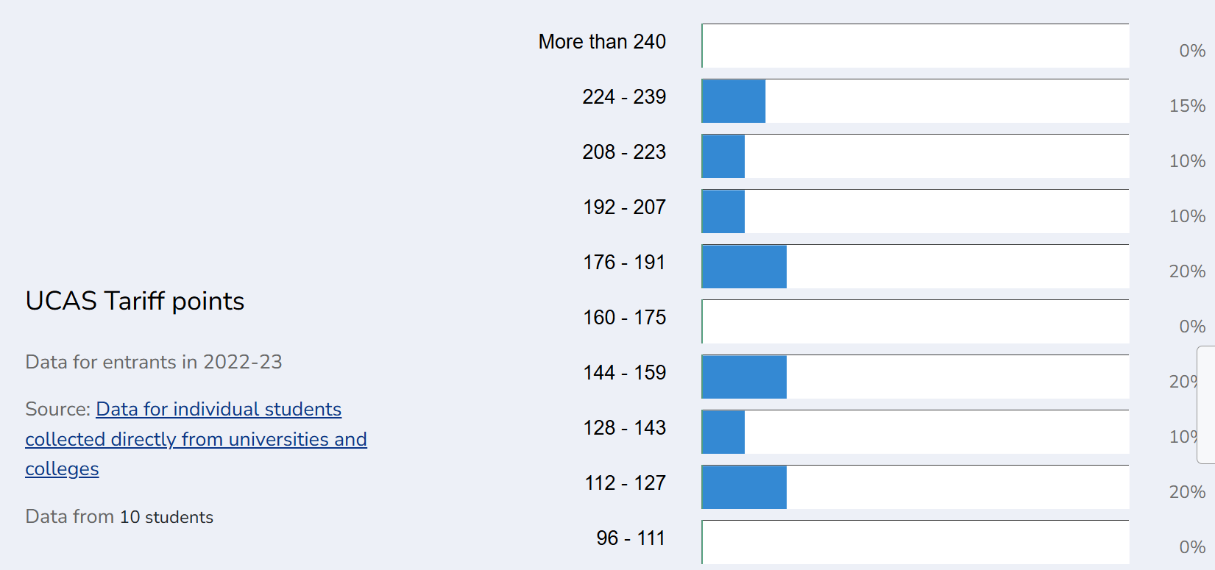

Slide 15



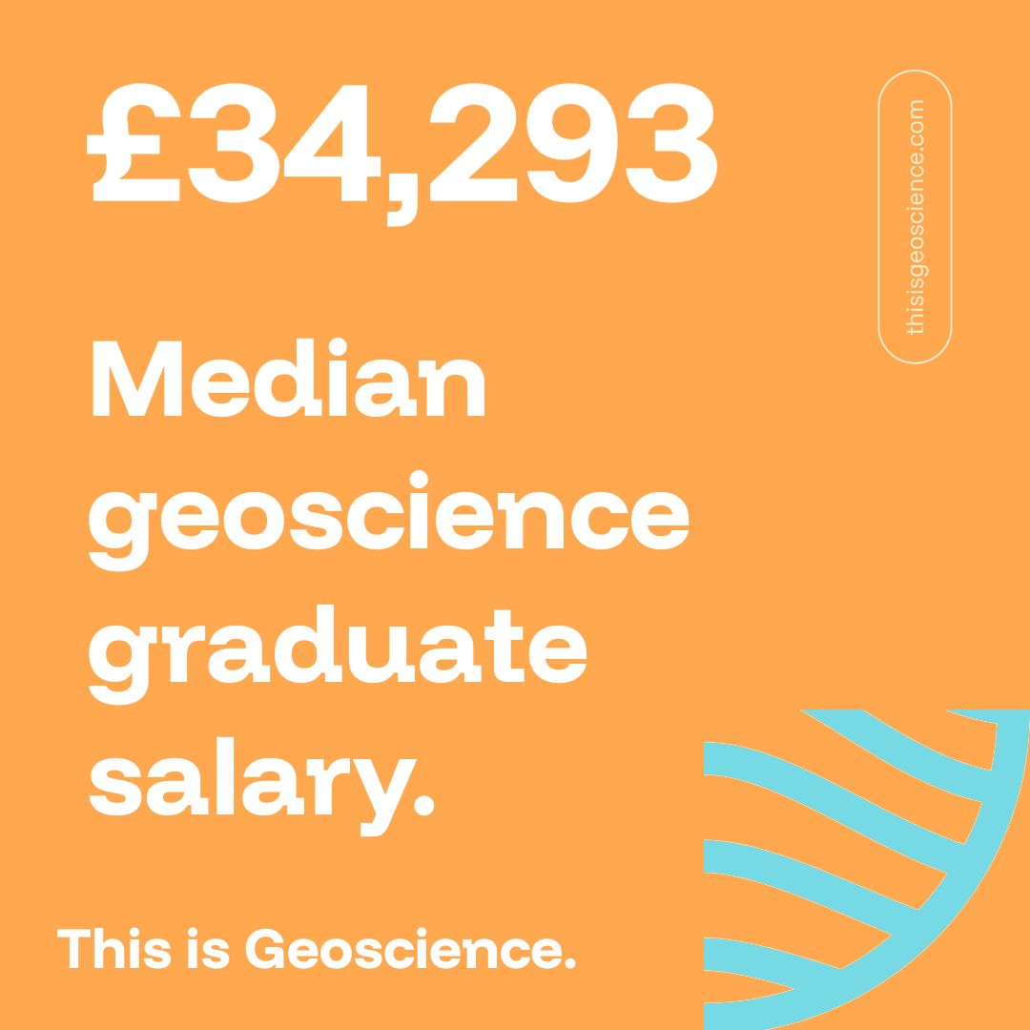
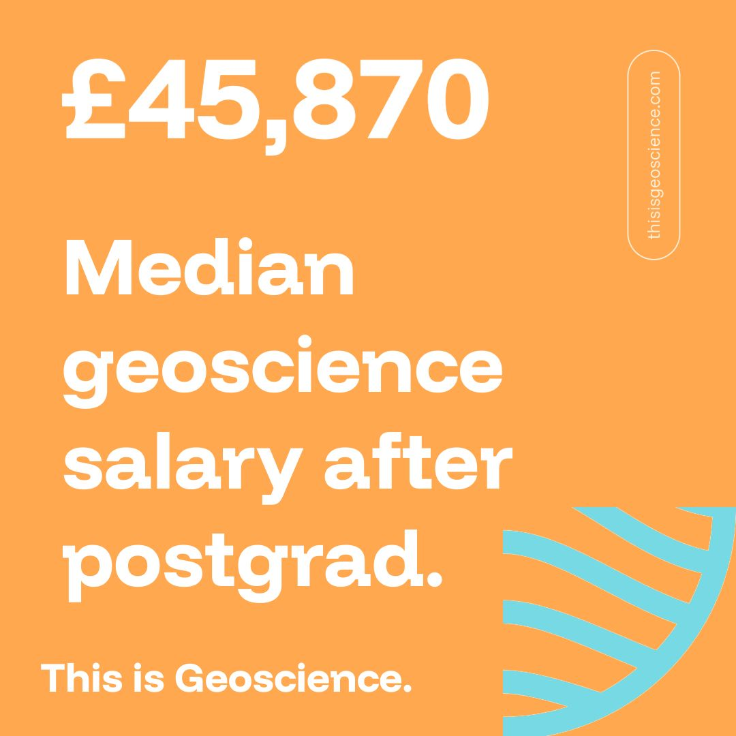
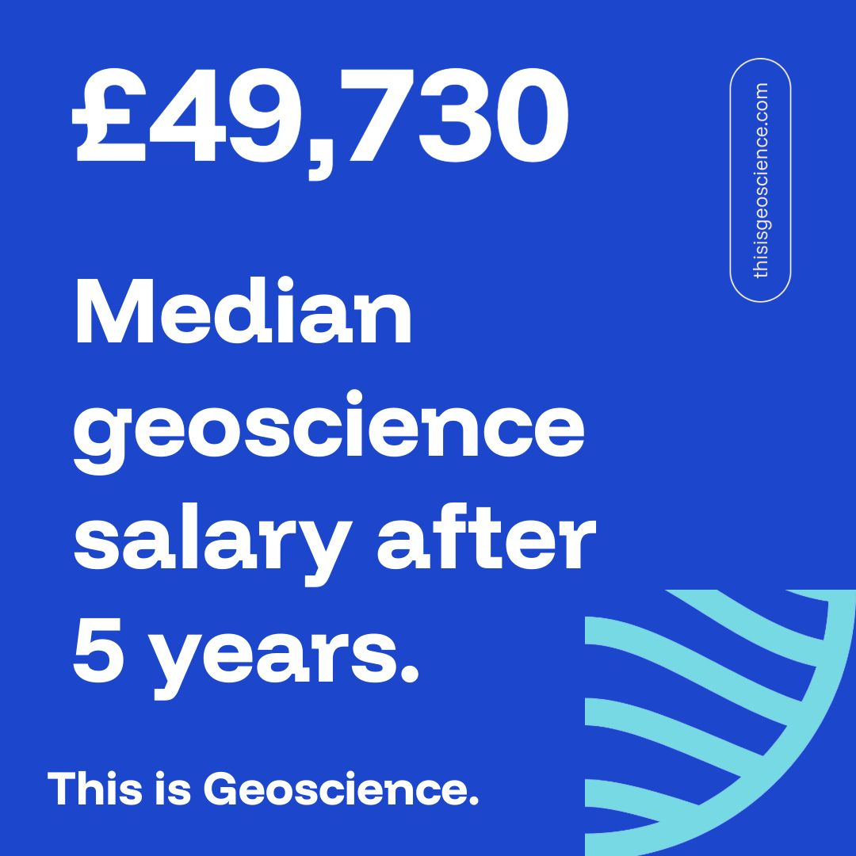
Reasons to study Geology 101
Based on research from the Department for Education (2025)

